Slide 1
Roles of The Medical Review Officer and The Medical Review Officer Assistant
Gina C. Pervall, MD Toni Clay
Chief, MDOT MVA Medical Advisory Board Cahill Swift, LLC
Glen Burnie, Maryland
14th Annual FTA Drug and Alcohol Conference April 2 – 4, 2019

Slide 2
Overview
The MRO and MRO-A
The MRO Verification Process
CCF Review
Fatal vs Non-Fatal Flaws
Donor Contact/Non-Contact Procedures
Drug Testing Programs
Donor Interview
Results Verification and Reporting
Discussion and Questions
Notes:
How presentation will benefit audience: Adult learners are more interested in a subject if they know how or why it is important to them.
Presenter’s level of expertise in the subject: Briefly state your credentials in this area, or explain why participants should listen to you.

Slide 3
Medical Review Officer

Slide 4
Medical Review Officer (MRO) Qualifications
Licensed MD or DO
Knowledgeable about:
Controlled substance use disorders
Issues related to alternative medical explanations, adulteration, substitution, and invalid test results
Current on DOT MRO Guidelines (§40.121) and DOT regulations applicable to employers

Slide 5
MRO Qualifications
Completes qualification training by nationally-recognized MRO training organization
Passes examination administered by national-recognized MRO certification board
Undergoes requalification training every 5 years
Subscribes to Office of Drug and Alcohol Policy & Compliance (ODAPC) list-serve

Slide 6
MRO Responsibilities
“Independent and impartial gatekeeper and advocate for the accuracy and integrity of the drug testing process.” (§40.123)
No doctor-patient relationship
No relationship (financial benefit) with employer’s lab
Provides quality assurance review
Review CCF
Investigate, correct problems and provide feedback to employers, collectors and labs
Consult with ODAPC on problems

Slide 7
MRO Responsibilities
Determines if donor has legitimate medical explanation for non-negative test result (positive, adulterated, substituted, invalid)
Ensures timely flow of information to employers
Protects confidentiality
Functions in compliance with DOT regulations

Slide 8
MRO Recordkeeping
One year: Lab-Negative or Cancelled drug-test records
Five years: Lab-Positive or Refusal-to-Test drug-test records
Minimum record: Copy 2 of CCF and interview notes
Drug-test records separate from patient medical records
Confidential

Slide 9
Medical Review Officer Assistant (MRO-A)

Slide 10
MRO-A
Enhances the efficiency and integrity of the drug testing review process
Assists in protecting the rights of the donor during the collection process
Must understand all aspects of the regulations
Not a regulated position
Certification is conducted by the Medical Review Officer Certification Council (MROCC)
Re-certification every 3 years
Notes:
Example objectives
At the end of this lesson, you will be able to:
Save files to the team Web server.
Move files to different locations on the team Web server.
Share files on the team Web server.

Slide 11
MRO-A Responsibilities

Slide 12
MRO-A Responsibilities
Assisting the MRO, Wherever Possible and Whenever Needed
Review CCFs
Investigate and correct problems
Request affidavits
Provide feedback to employers, collectors, and laboratories
Consult and report to the Office of Drug and Alcohol Policy and Compliance (ODAPC)
Report laboratory negative drug test results
MRO must review 5% of all negative CCFs
ALL results reported by the MRO-A that required corrective action

Slide 13
MRO-A Responsibilities (Continued)
Assisting the MRO, Wherever Possible and Whenever Needed
Contact donors to schedule the MRO interview
Obtain Copy 1 of the CCF from the laboratory
Report a negative dilute that does NOT require re-collection under direct observation
Ensure the timely flow of test results (including split specimens)
Transmit results to the DER AFTER the MRO has completed the donor interview
MRO-A must protect the confidentiality of drug testing information

Slide 14
MRO-A CCF Review
Matching specimen ID number on CCF and laboratory report
Testing authority
Reason for testing
Temperature box
Collector’s printed name and signature
Donor’s printed name and signature
Observed collection box checked (return to duty test, F.U., etc.)
Notations in the “Remarks” section (i.e. - dual collection for temperature out of range)

Slide 15
What Else Could Go Wrong?

Slide 16
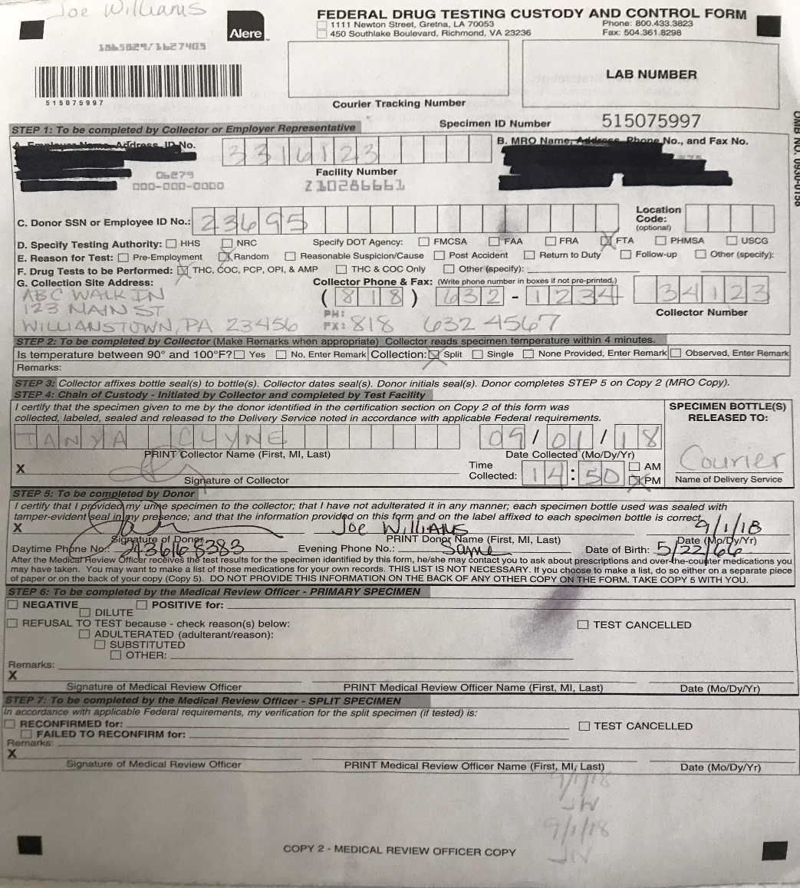

Slide 17
MRO-A Restrictions
Gather medical information
Determine legitimate medical explanations for laboratory confirmed positives, adulterated, substituted, or invalid drug tests
Conduct the donor interviews
Be involved in the shy bladder evaluation (except assisting MRO with paperwork)
Cancel a drug test

Slide 18
Other Ways to Assist

Slide 19
Fatal Flaws -vs- Correctable Flaws
FATAL FLAWS (Section 40.199)
CORRECTABLE FLAWS (Section 40.203)
Collectors name AND signature are missing
Specimen IDs on bottle and CCF don’t match
Specimen bottle seals are broken or show evidence of tampering
Leakage or insufficient quantity in primary specimen and the split cannot be re-designated
**New As of January 1, 2018
No CCF submitted with the urine specimen
No urine specimen submitted with the CCF
Two separate collections performed using one CCF
Test must be reviewed and canceled by the MRO, cannot be corrected
MRO-A may send documentation to require Error Correction Training (ECT)
Temperature box not checked
Collector’s signature missing (Step 4)
Employee signature is missing (but name is printed) and no notation
A non-DOT CCF used for DOT drug test
MRO-A may request affidavits and follow-up on correctable flaws
If no affidavit is received or the correction made, ONLY the MRO can cancel the test

Slide 20
Making Contact
MRO-A
DAPM/DER
Initially, call the donor
At least (3) three attempts in 24 hours
Call the DAPM/DER
Donor number not in service/Wrong number
Unable to reach the donor in 24 hours
At least (3) three attempts in 24 hours
Contacts the donor
Inform the donor they have 72 hours to contact the MRO
Inform MRO office of contact date and time
Unable to locate/contact the donor
Inform the MRO’s office
No contact positive reported 10 days from date of the lab result

Slide 21
Contact Concerns
Don’t assume the worse
Valid prescription = Negative
Stand-Down (Section 40.21)
Waiver must be pre-approved by the agency DAPM (FTA - Iyon Rosario)
MRO would inform the DER of the lab result prior to the donor interview
Temporarily Medically Unqualified
If the DER is unable to contact the donor – should not perform safety-sensitive functions

Slide 22
Drug Testing Programs

Slide 23
Know the Employer’s Program
Regulated (DOT) Screens
Parameters set by the government
Urine
Split collections
HHS-certified lab
5-panel test
Specimen validity testing
Screening and confirmation
Non-regulated (Non-DOT) Screens
Parameters set by the employer
Urine, Hair, Blood, Saliva
Single or split collection?
Lab certification?
#-panel test?
Confirmation used?

Slide 24
5 Panel DOT Drug Test
Marijuana (THC)
Cocaine
Amphetamines
Amphetamine, Methamphetamine, MDMA, MDA
Opioids
Codeine, Morphine, 6-AM (heroin), Hydrocodone, Hydromorphone, Oxycodone, Oxymorphone
Phencyclidine (PCP)
Confirmation of 14 Drugs

Slide 25
The Interview

Slide 26
MRO Verification - HIPAA
HIPAA does not apply during MRO verification process
DO NOT need and MUST NOT attempt to obtain a donor’s permission:
To verify drug test results
For consultation with prescribing physician or pharmacist
To report results and fitness-for-duty concerns to employers
To consult with Substance Abuse Professional (SAP)

Slide 27
MRO Verification – Interview
Required to personally speak with donor
Explain verification interview process
Notify that employer will be notified of verified results and medical information affecting the performance of safety-sensitive duties
Notify of specific lab results
Request explanation (donor has burden of proof)
Notify of requirement for further evaluation, if indicated

Slide 28
Verification and Reporting

Slide 29
MRO Verification
Specimen Collection
Laboratory
Non-Negative Result
Negative Result
Reports to employer/agency
Medical Review Officer (MRO): review for possible alternate medical explanations prior to reporting results to agency/employer
MRO finds the results are Medically Justified– reports Negative result to employer/agency
No, or Non-Medical explanation of lab’s non-negative findings– MRO reports Positive result to employer/agency and, in FMCSA cases, the Clearinghouse

Slide 30
MRO Verification - Prescribed Medications
Verify Prescription is Legally Valid & Medically Necessary
Verify authenticity of prescription with pharmacist or treating physician
No guidance on length of time a prescription is valid after issuance
Notify donor of up to 5 days to have the prescribing provider make contact (with MRO) to discuss concerns of safety risk

Slide 31
Legitimate Treatment Examples
Lab Confirmed Positive and Verified MRO Negative
Codeine prescriptions for coughing and/or pain
Narcotic analgesics prescribed for pain
Prescribed tetrahydrocannabinol (cancer, AIDS, anorexia)
Prescribed cocaine as a topical or anesthetic

Slide 32
5-Day Waiting for Prescription Review
Legitimate Prescription for Controlled Dangerous Substance (CDS)
Immediately report verified MRO negative result to employer
Legitimate Prescription for CDS BUT Concern
Allow up to 5 days from date of report of verified negative result for donor to have prescribing physician contact MRO to determine if medication can be changed to one that does not make donor medically unqualified or pose a significant safety risk

Slide 33
Fitness-for-Duty
MRO is always responsible to raise fitness-for-duty consideration
Notify employer immediately (5-day rule inapplicable)
Donor declines to have prescribing physician speak with MRO
Prescribing physician speaks with MRO, but safety risk remains unresolved
Donor discloses medical condition that would result in donor being medically unqualified
Note: Donor’s explanation remains confidential if valid medical reason for prescription AND no concerns for fitness-for-duty

Slide 34
Methamphetamines
Amphetamine Positive
Methamphetamine Negative
Use of amphetamine/drug metabolized to amphetamine
Methamphetamine Positive – d and l enantiomers
l -methamphetamine corresponds with OTC nasal inhalers (Vicks) or selegiline
80/20 guideline: >80% l -methamphetamine is consistent with Vicks >20% d -methamphetamine is consistent with prescription or illicit drug

Slide 35
Opioids
6-acetylmorphine (6-AM) is always verified as positive (heroin)
Morphine or codeine confirmed at > 15,000 ng/ml
MRO negative if: legitimate medical explanation (NOT poppy seeds)
MRO positive if: no medical explanation, clinical evidence of unauthorized use
Face-to-face examination
Morphine or codeine confirmed at < 15,000 ng/ml
MRO has burden of proof to show unauthorized use

Slide 36
Marijuana
MRO must not verify a test as negative based on medical marijuana regardless of state laws
Do not accept use of hemp, CBD, or any marijuana-related product as basis for MRO negative verification
THC-V Testing
GC/MS testing for THCV metabolite
Presence indicates herbal versus pharmaceutical THC (Marinol/dronabinol) (absence does not disprove herbal marijuana)

Slide 37
Negative Dilute Specimen
Creatinine >= 2 and < 20 mg/dL AND Specific Gravity > 1.0010 and < 1.0030
Verification
Negative AND Dilute
Remarks
Recollect ASAP – employers option
Recollect ASAP under direct observation when Cr < 5 mg/dL

Slide 38
Invalid Specimen
Discuss with certifying scientist
Oxidant activity
Abnormal pH > 3 and < 4.5 or > 9 and < 11
Exception for pH > 9.0 and < 9.5: if more than one day between collection and lab receipt and specimen was subject to warm temperature
Low creatinine (< 2 mg/dL) OR low specific gravity (< 1.0010)
Abnormal physical characteristics (foaming or color)
Red - menstrual blood
Blue/Green – amitriptyline, indomethacin, methanamine, doxorubicin
Orange – pyridium, rifampin, laxatives, warfarin

Slide 39
Invalid Specimen
Verification
Acceptable explanation
Test cancelled and remark Invalid Result AND No further action*
*No further action unless negative result required (Pre-Employment, RTD, FU)
If negative result required, MRO verification is based on clinical evidence
No acceptable explanation
Test cancelled AND remark Invalid Result AND Recollect under Direct Observation
Notify employer for immediate recollection if this specimen produces another invalid result for a different reason (DO NOT contact donor)

Slide 40
Examination - Negative Test Result Required
MRO makes determination based on clinical evidence of illicit drug use
Long-term medical condition that affects ability to produce a valid specimen
Face-to-face medical examination required
Alternative testing allowed (blood, hair)
Verification
Negative if NO clinical evidence of drug use
Test Cancelled if clinical evidence of drug use
Refusal To Test if donor fails to undergo examination

Slide 41
Adulterated Specimen
pH < 4 or >= 11 or Nitrite >= 500 ug/mL
Donor must demonstrate that adulterant (soap, bleach, glutaraldehyde, surfactant) entered the specimen through physiologic means
MRO may direct for evaluation by physician with expertise in medical issue raised
Verification
Test Cancelled AND inform ODAPC for acceptable explanation
Refusal To Test AND Adulterated if NO acceptable explanation or donor admits

Slide 42
Substituted Specimen
Creatinine < 2 mg/dL AND Specific Gravity <= 1.0010 or >= 1.0200
Donor much demonstrate the ability to produce urine through physiologic means
Verification
Test Cancelled AND inform ODAPC for acceptable explanation
Refusal To Test AND Substitution if NO acceptable explanation

Slide 44
Rejected Specimen
Due to fatal flaw
Verification
Test Cancelled AND No further action unless negative result required

Slide 45
Shy Bladder
Quantity Nonsufficient in One Void in 3-Hour Period
Donor referred to undergo evaluation by a physician with expertise in medical issue raised
DOT stand-down waiver
Physiological condition or documented pre-existing psychological disorder (dehydration, situational anxiety)
Verification
Test Cancelled if valid medical explanation
Refusal To Test if no medical explanation

Slide 46
Split Specimen Test
Offered for verified positive, adulterated or substitution
Donor has 72 hours to request split testing
Upon request MRO immediately arranges for specimen transfer from Lab A to Lab B (donor is not required to pay before the test takes place)
Initial non-negative verification is immediately reported to employer – DO NOT wait for results of split specimen

Slide 47
Split Specimen Verification
Reconfirmed when Lab B reconfirmed primary results of Lab A
Failed to Reconfirm AND Test Cancelled
Lab B failed to reconfirm primary results of Lab A
Lab B failed to reconfirm primary results of Lab A AND Lab B results are invalid, adulterated or substituted
Proceed with MRO verification of Lab B results
Notify ODAPC
Test Cancelled AND Immediately retest under direct observation when split specimen is unavailable for testing
Notify ODAPC
Employer action against donor is reversed when failed to reconfirm/test cancelled

Slide 48
Non-Negative Verification Without Interview
Donor declines to discuss test
Donor has not contacted MRO and more than 72 hours have passed since DER successfully contacted donor
MRO and DER unable to contact employee within 10 days of date when MRO received confirmed test result

Slide 49
Changing a Verified Result
MRO may reopen verification that was made without an interview
Donor has documentation of serious illness/injury or circumstance that precluded contact
Within 60 days – MRO may change verification
More than 60 days – MRO must contact ODPAC before changing verification
Laboratory error
Administrative error by MRO

Slide 50
Discussion and Questions

Slide 51
Return-to-Duty Positive THC Lab Report
Explanation: I smoked marijuana last week during a ski trip in Colorado.
What is the verification?
Do you offer split testing?

Slide 52
Return-to-Duty Positive THC Lab Report
Explanation: I smoked marijuana last week during a ski trip in Colorado.
What is the verification – Positive for marijuana
Do you offer split testing – Yes
Split fails to reconfirm.
What do you do?

Slide 53
Return-to-Duty Positive THC Lab Report
Explanation: I smoked marijuana last week during a ski trip in Colorado.
What is the verification – Positive for marijuana
Do you offer split testing – Yes
Split fails to reconfirm
Verification: Failed to Reconfirm and Test Cancelled
Remarks: Recollect under direct observation ASAP
Notify ODAPC of failure to reconfirm

Slide 54
Return-to-Duty Positive THC Lab Report
Explanation: I smoked marijuana last week during a ski trip in Colorado.
What is the verification – Positive for marijuana
Do you offer split testing – Yes
Split fails to reconfirm- Verified as Failed to Reconfirm, Test Cancelled, recollect under direct observation
Recollection lab report negative results, CCF shows test not observed
What do you do?

Slide 55
Return-to-Duty Positive THC Lab Report
Explanation: I smoked marijuana last week during a ski trip in Colorado.
What is the verification – Positive for marijuana
Do you offer split testing – Yes
Split fails to reconfirm- Verified as Failed to Reconfirm, Test Cancelled, recollect under direct observation
Recollected lab report negative, CCF shows test not observed
Verification: Test Cancelled
Remarks: Not Collected Under Direct Observation, Recollect under direct observation ASAP

Slide 56
Return-to-Duty Positive THC Lab Report
Explanation: I smoked marijuana last week during a ski trip in Colorado.
What is the verification – Positive for marijuana
Do you offer split testing – Yes
Split fails to reconfirm AND is adulterated with bleach
What do you do?

Slide 57
Return-to-Duty Positive THC Lab Report
Explanation: I smoked marijuana last week during a ski trip in Colorado.
What is the verification – Positive for marijuana
Do you offer split testing – Yes
Split fails to reconfirm AND is adulterated with bleach
Interview donor regarding Lab B adulterated results
No acceptable explanation
Now what?

Slide 58
Return-to-Duty Positive THC Lab Report
Explanation: I smoked marijuana last week during a ski trip in Colorado.
What is the verification – Positive for marijuana
Do you offer split testing – Yes
Split fails to reconfirm AND is adulterated with bleach.
No acceptable explanation for adulterated specimen
Verification: Failed to Reconfirm
Remarks: Refusal to Test due to adulteration
Allow donor 72 hours to request retest of Lab A specimen
Notify ODAPC

Slide 59
Random Morphine/Codeine Positive Lab Report
Morphine/Codeine @ 12,000 ng/mL
Explanation: My wife gave me some of her pain pills for my backache.
What is the verification?

Slide 60
Random Morphine/Codeine Positive Lab Report
Morphine/Codeine @ 12,000 ng/mL
Explanation: My wife gave me some of her pain pills for my backache.
Verification
Positive for opioids
Remarks: Unauthorized use of controlled substance

Slide 61
Random Morphine/Codeine Positive Lab Report
Morphine/Codeine @ 18,000 ng/mL
Explanation: I have a prescription for Tylenol #3 for my back pain.
What do you do?

Slide 62
Random Morphine/Codeine Positive Lab Report
Morphine/Codeine @ 18,000 ng/mL
Explanation: I have a prescription for Tylenol #3 for my back pain.
Prescription authenticated
Verification: Negative
Remarks: Prescription verified
Now what?

Slide 63
Random Morphine/Codeine Positive Lab Report
Morphine/Codeine @ 18,000 ng/mL
Explanation: I have a prescription for Tylenol #3 for my back pain.
Prescription authenticated and verified as Negative
Fitness-for-Duty Evaluation
Discussion with prescribing physician: donor has chronic pain due to lumbar HNP with limited ROM and NEEDS Tylenol #3 @ 2 tablets every 4 hours
Notify employer of concerns regarding fitness-for-duty (notify if no discussion)

Slide 64
Random Invalid Lab Report
Certifying Scientist States Specimen Was Orange
Explanation: Started taking TB medications, INH and Rifampin, last month.
What do you do?

Slide 65
Random Invalid Lab Report
Certifying Scientist States Specimen Was Orange
Explanation: Started taking TB medications, INH and Rifampin, last month.
Authenticated Rifampin - 5 months remaining
Verification: Test Cancelled
Remarks: Medication interfering with lab testing, Recollection NOT indicated

Slide 66
Pre-employment Invalid Lab Report
Certifying Scientist States Specimen Was Orange
Explanation: Started taking TB medications, INH and Rifampin last month.
Authenticated Rifampin – 5 months remaining
Now what and why?

Slide 67
Pre-employment Invalid Lab Report
Certifying Scientist States Specimen Was Orange
Explanation: Started taking TB medications, INH and Rifampin last month.
Authenticated Rifampin – 5 months remaining
Face-to-face physical examination because negative result required for pre-employment test
No evidence of drug use
Verification: Negative

Slide 68
Pre-employment Invalid Lab Report
Certifying Scientist States Specimen Was Orange
Explanation: Started taking TB medications, INH and Rifampin last month.
Authenticated Rifampin – 5 months remaining
Face-to-face physical examination because negative result required for pre-employment test
Fresh needle tracks on feet
Verification: Test Cancelled
Remarks: Clinical evidence of drug use (failed to undergo examination)

Slide 69
Shy Bladder
Explanation: I have kidney stones.
Recommended local MRO or Urologist for evaluation
Provides letter from PCP stating donor was unable to void due to UTI
Request urinalysis supporting diagnosis of UTI
No medical documentation to support UTI (normal U/A)
Verification: Refusal to Test

Slide 70
Two-Specimen Collections
Temperature-Out-of-Range and Observed Collection
1st lab report is negative
2nd lab report is pending
What do you do?

Slide 71
Two-Specimen Collections
Temperature-Out-of-Range and Observed Collection
1st lab report is negative
2nd lab report is pending
Do not report results of 1st specimen until lab report of 2nd is received

Slide 72
Two-Specimen Collections
Temperature-Out-of-Range and Observed Collection
1st lab report is positive
2nd lab report is pending
What do you do?

Slide 73
Two-Specimen Collections
Temperature-Out-of-Range and Observed Collection
1st lab report is positive
2nd lab report is pending
Immediately report result of 1st specimen

Slide 74
Thank you

